Slide 1
Gujarat Directory
Created By - Jyot Sheth

Slide 2
Gujarat Directory
A directory is a book which gives lists of facts, for example people's names, addresses, and phone numbers, or the names and addresses of Doctors of gujarat , usually arranged in alphabetical order.
a directory contained inside another directory is called a subdirectory.

Slide 3
Advantages
In this we can find the name of Doctors of Gujarat
→ In This the needy people can contact the doctors very easily .
→ It provides fast services to needy people .
→ And it is very sucessfully running.

Slide 4
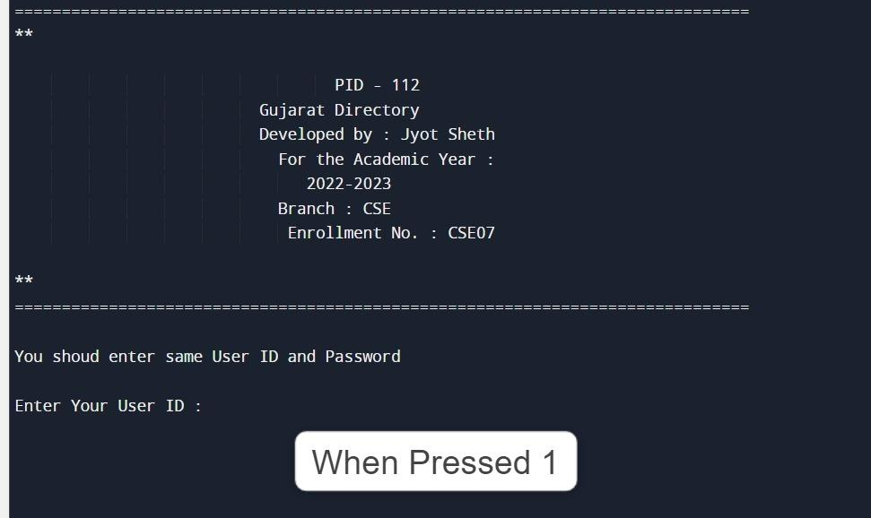

Slide 5
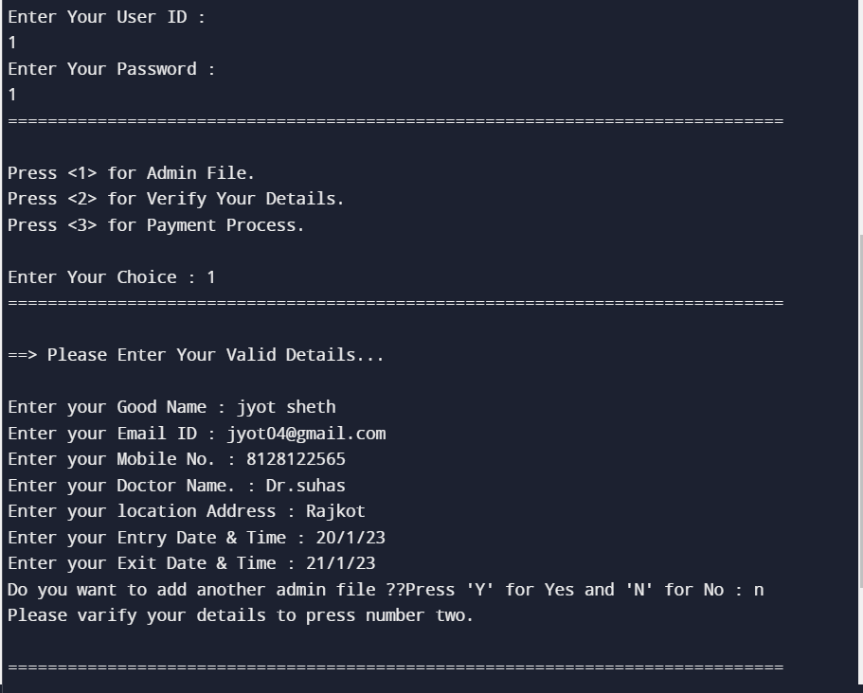

Slide 6
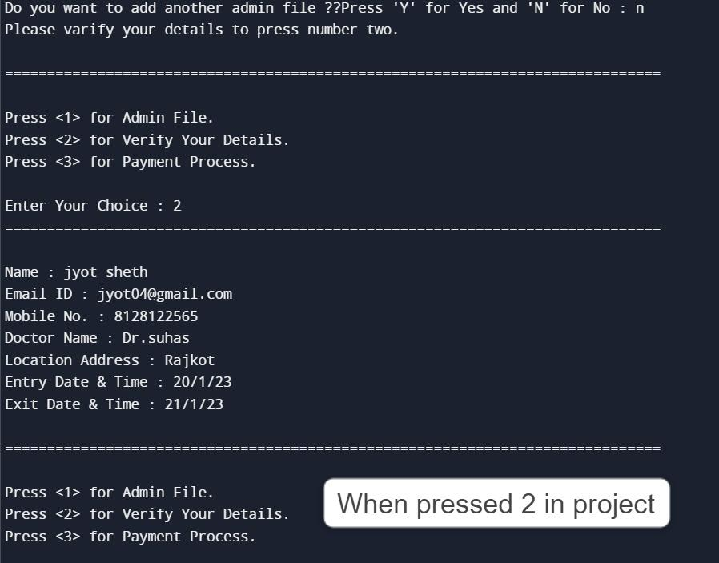

Slide 7
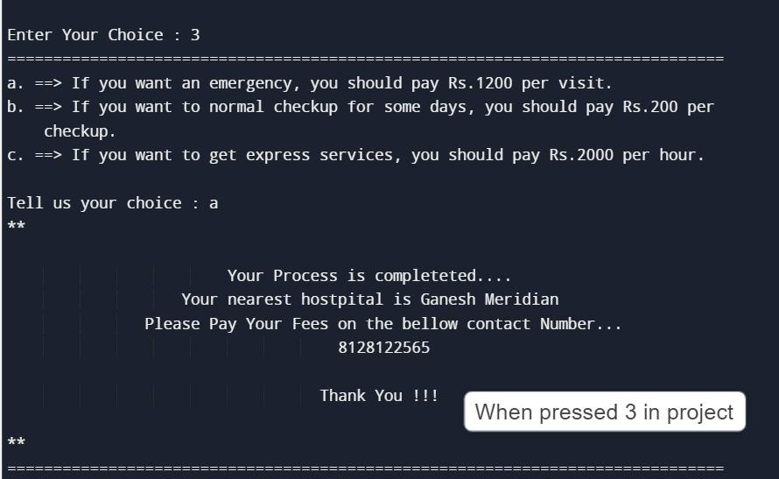

Slide 8
Thanks for Visiting
My Project

